Slide 1


Ticketak
(Ticket Management System)

Slide 2
Team Members
Name
Ahmad Reda Bayoumy
George Mariey
Karim Mohamed Shebl
Omar Mohammed Fayek Mostafa
Mohammed Abdallah Owais
Fady Adel Botros Awdallah

Slide 3
Agenda
Introduction
Project Requirements
UML Diagrams
Project Implementation

Slide 4
Introduction
Ticketak is a ticket management system designed to streamline the process of event creation, ticket booking, and event management.
The system supports role-based access, allowing:
Users (Fans) to register, browse events, search by category, purchase tickets, and manage their booked events.
Administrators to create, update, and manage events, control ticket availability, and monitor event details.

Slide 5
Project Requirements
Ticketak Requirements
Task & Sprint Management (Jira)

Slide 6
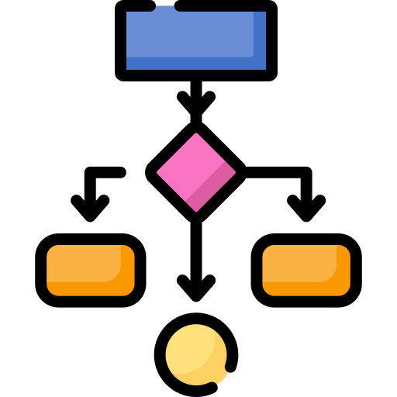
UML Diagrams

Slide 7
Class Diagram
Ticketak Class Diagram

Slide 8
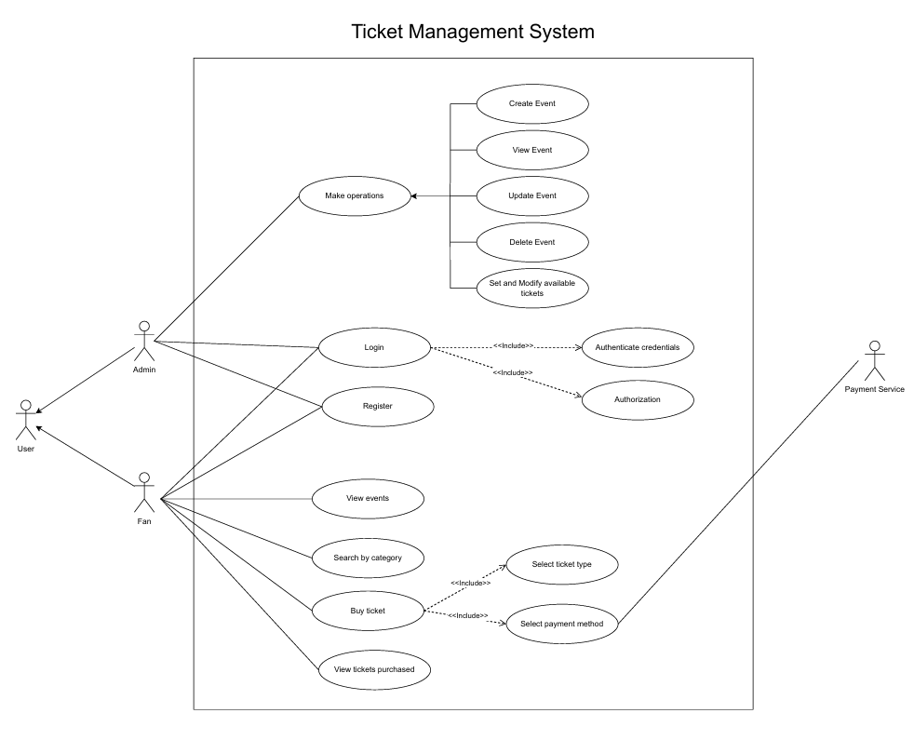
Use Case Diagram

Slide 9
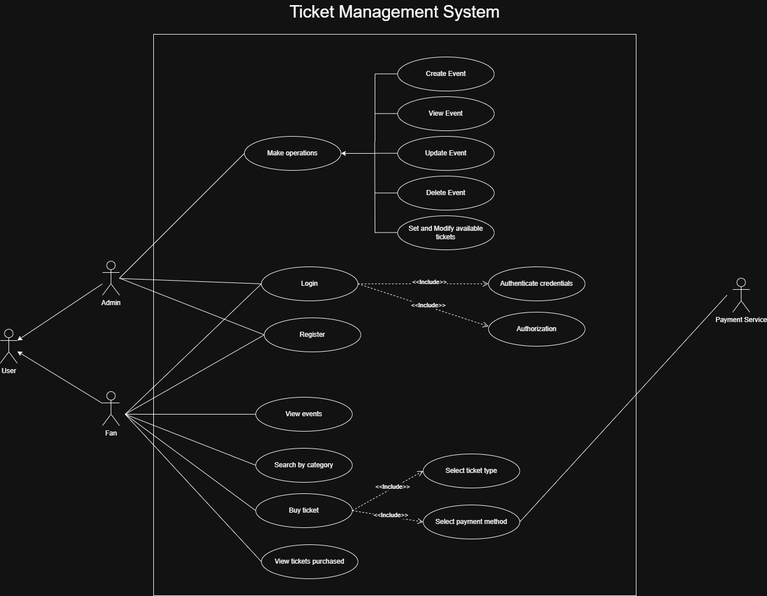
Use Case Diagram

Slide 10
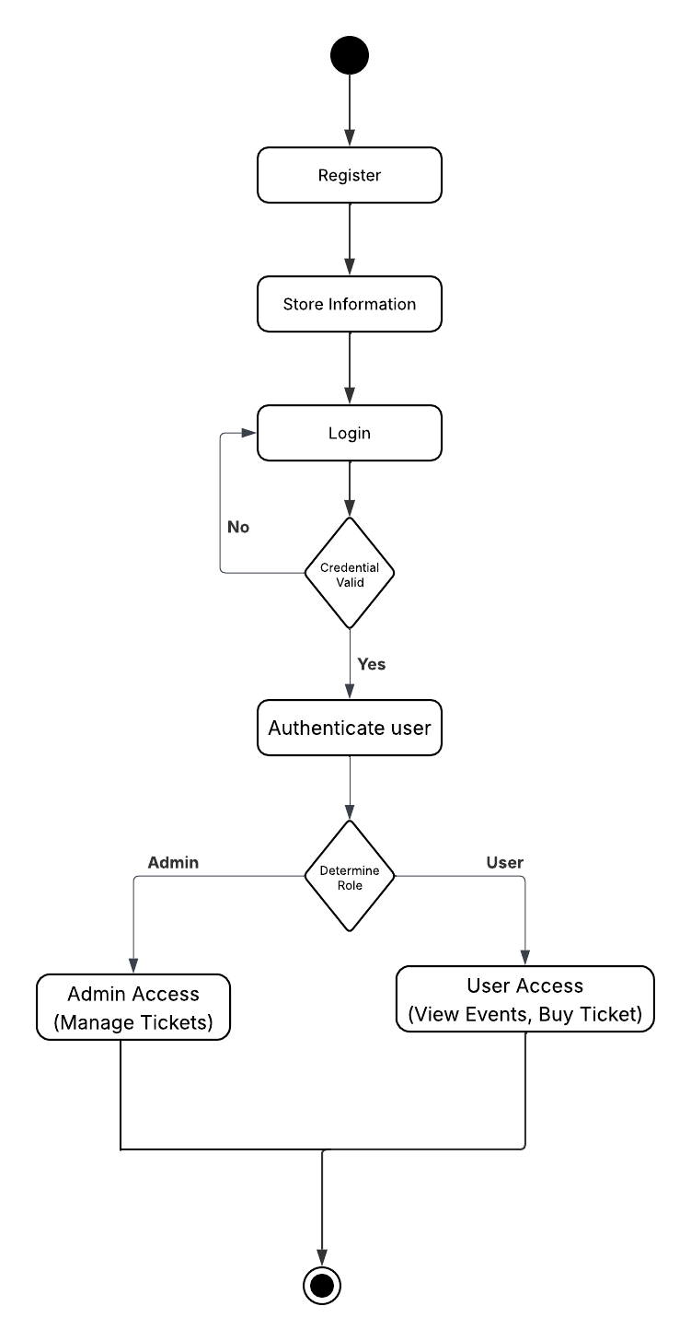
Activity Diagrams
Authentication and Authorization Diagram:

Slide 11
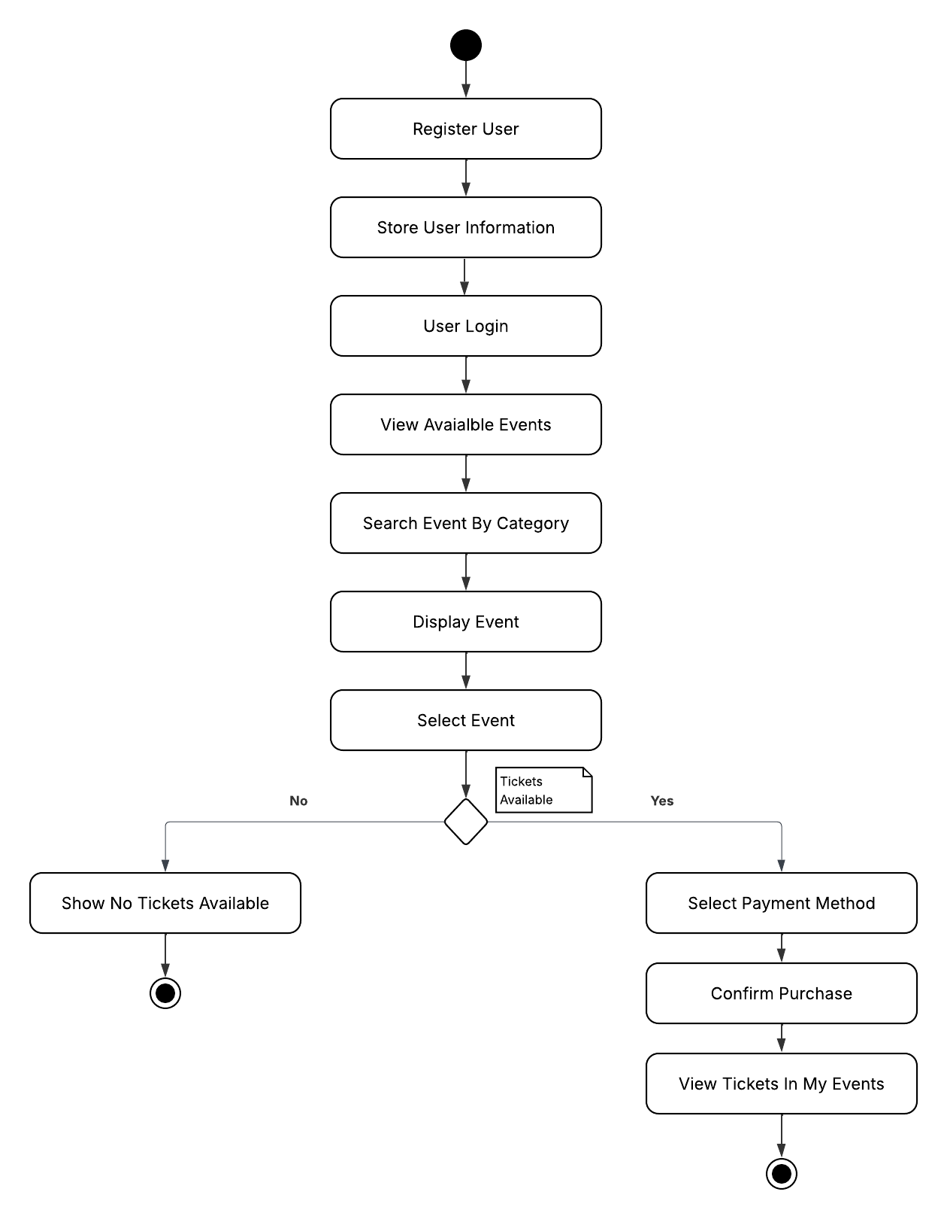
Activity Diagrams
User Management Diagram:

Slide 12
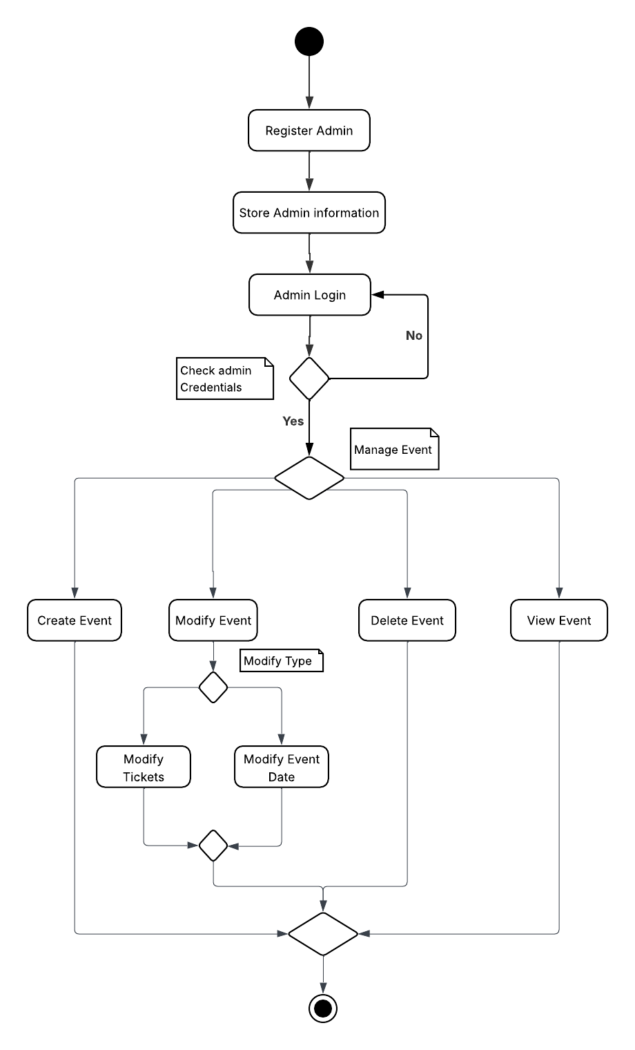
Activity Diagrams
Admin Management Diagram:

Slide 13
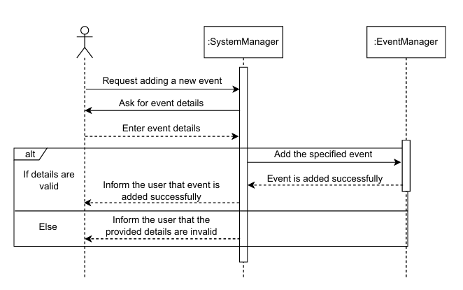
Sequence Diagrams
Add Event Diagram:

Slide 14
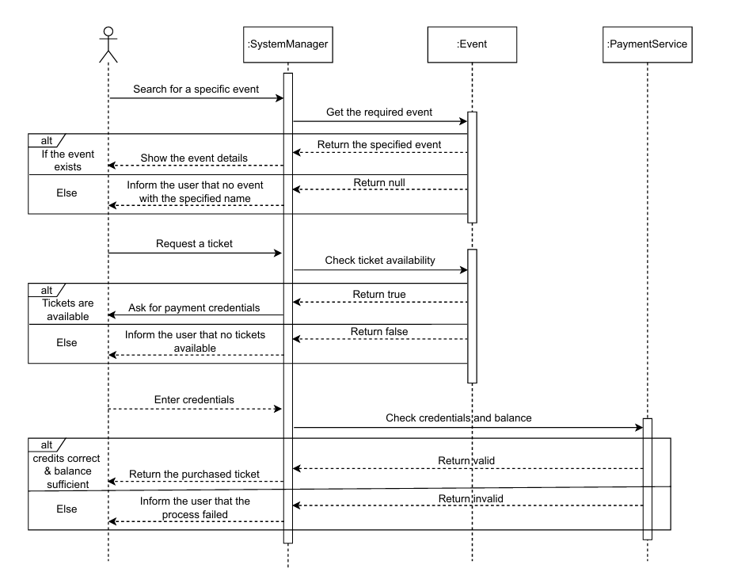
Sequence Diagrams
Buy Ticket Diagram:

Slide 15
Project Implementation
GitHub Repo

Slide 16
Thank you

